Slide 1
THE NICHE

Slide 2
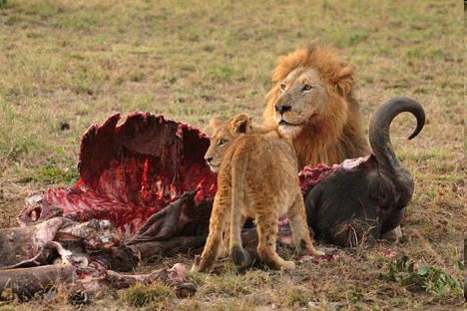
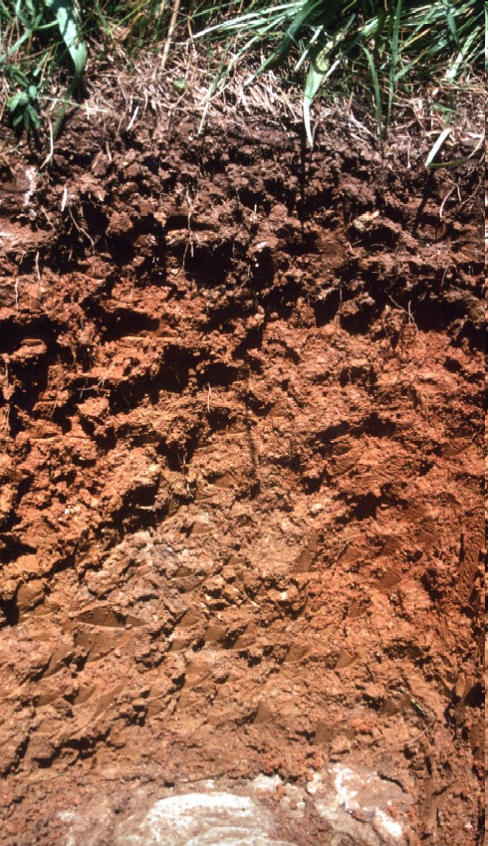
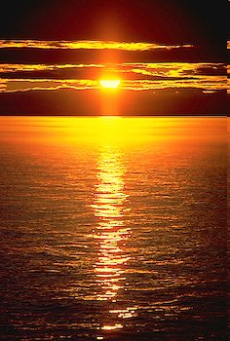
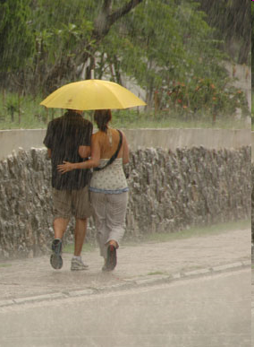
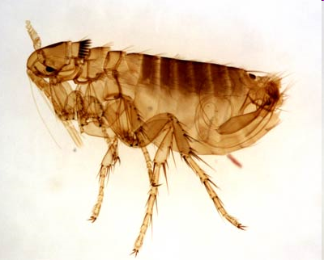
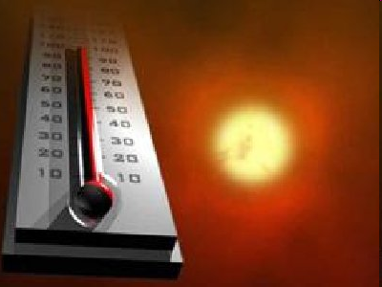
Habitat
The set of environmental conditions in which a certain species lives and is best suited to. Includes:
BIOTIC factors (other living things e.g. predators, food species, parasites)
ABIOTIC factors (non-living things e.g. light, temp., water, salinity, soil)

Slide 3
Ecological Niche
This is the “job” or role of the organism in a community.
Describes how the organism uses its adaptations to exploit the opportunities in its habitat.
Starts by saying its feeding level, (producer, herbivore, carnivore) and then describes exactly how it fits in to the habitat.

Slide 4
Fundamental Niche
The niche of an organism in an ideal situation.
Most organisms live in a narrower “realised niche” due to interactions with other species and the environment

Slide 5
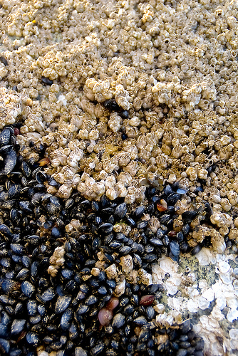
Example
The barnacles at the top of this rock are forced into a less desirable, more exposed position by the mussels below them.
Realised niche
Fundamental niche for barnacles

